Slide 1
CPSC331 - Spring 2019 Tutorial 12
Khobaib Zaamout

Slide 2

Q1: Prove the Key Property
Prove that the “Key Property” is satisfied by every node $x$ in this BST.

Slide 3
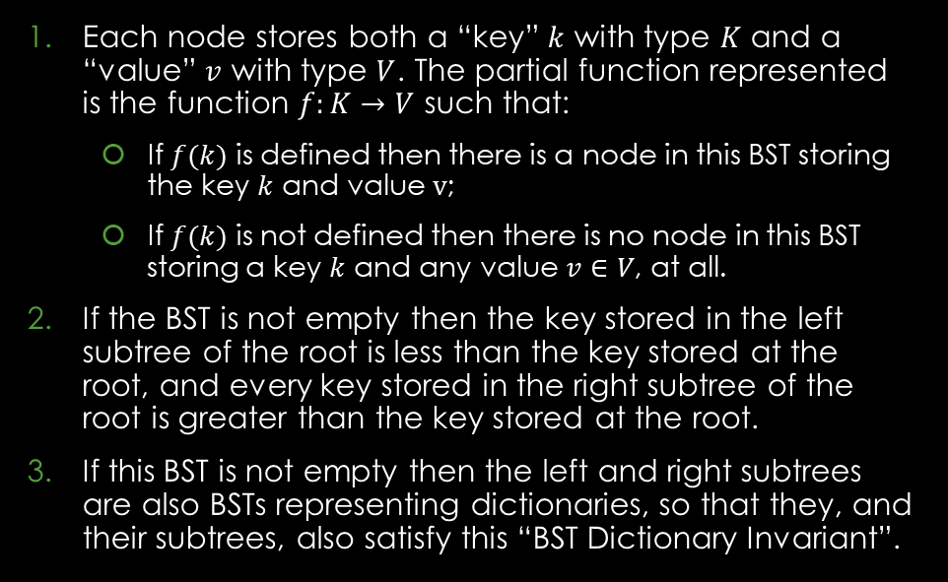
Q1: Prove the Key Property - Background
Algorithm:
BST Dictionary Invariant:
COPY IT FROM TUTORIAL EXERCISES DOCUMENT
Each node stores both a “key” $k$ with type $K$ and a “value” $v$ with type $V$. The partial function represented is the function $f:K→V$ such that:
If $f(k)$ is defined then there is a node in this BST storing the key $k$ and value $v$;
If $f(k)$ is not defined then there is no node in this BST storing a key $k$ and any value $v∈V$, at all.
If the BST is not empty then the key stored in the left subtree of the root is less than the key stored at the root, and every key stored in the right subtree of the root is greater than the key stored at the root.
If this BST is not empty then the left and right subtrees are also BSTs representing dictionaries, so that they, and their subtrees, also satisfy this “BST Dictionary Invariant”.

Slide 4
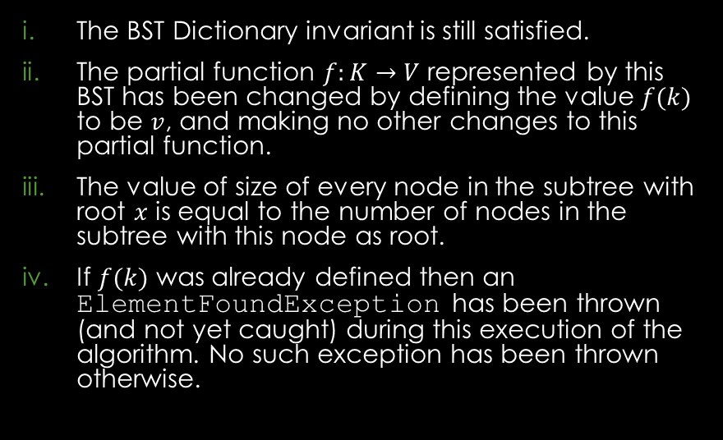
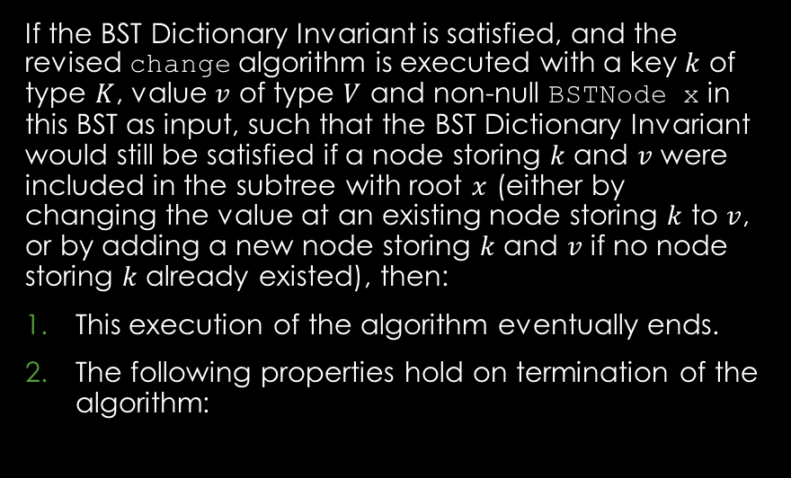
Q1: Prove the Key Property - Background
Key Property:
Key Property continued:
If the BST Dictionary Invariant is satisfied, and the revised change algorithm is executed with a key $k$ of type $K$, value $v$ of type $V$ and non-null BSTNode x in this BST as input, such that the BST Dictionary Invariant would still be satisfied if a node storing $k$ and $v$ were included in the subtree with root $x$ (either by changing the value at an existing node storing $k$ to $v$, or by adding a new node storing $k$ and $v$ if no node storing $k$ already existed), then:
This execution of the algorithm eventually ends.
The following properties hold on termination of the algorithm:
The BST Dictionary invariant is still satisfied.
The partial function $f:K→V$ represented by this BST has been changed by defining the value $f(k)$ to be $v$, and making no other changes to this partial function.
The value of size of every node in the subtree with root $x$ is equal to the number of nodes in the subtree with this node as root.
If $f(k)$ was already defined then an ElementFoundException has been thrown (and not yet caught) during this execution of the algorithm. No such exception has been thrown otherwise.

Slide 5
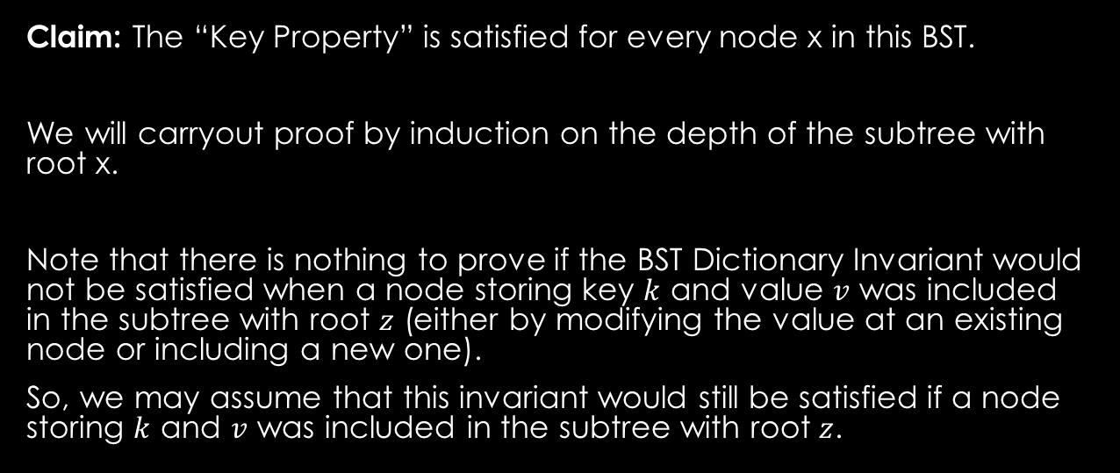
Q1: Prove the Key Property - Proof
Work Area:
Proof outline:
Claim: The “Key Property” is satisfied for every node x in this BST.
We will carryout proof by induction on the depth of the subtree with root x.
Note that there is nothing to prove if the BST Dictionary Invariant would not be satisfied when a node storing key $k$ and value $v$ was included in the subtree with root $z$ (either by modifying the value at an existing node or including a new one).
So, we may assume that this invariant would still be satisfied if a node storing $k$ and $v$ was included in the subtree with root $z$.
Basis
Inductive Step:
Inductive Hypothesis
Inductive Claim
Proof Steps
Proof Closure

Slide 6
Q1: Prove the Key Property - Proof
Work Area:
Proof outline:
Basis
Inductive Step:
Inductive Hypothesis
Inductive Claim
Proof Steps
Proof Closure

Slide 7
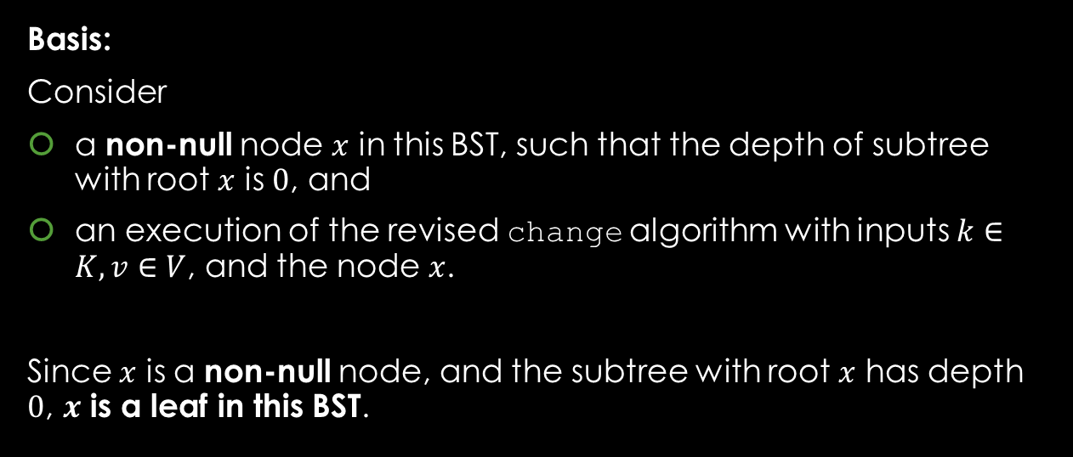
Q1: Prove the Key Property - Proof
Work Area:
Proof outline:
Basis:
Consider
a non-null node $x$ in this BST, such that the depth of subtree with root $x$ is $0$, and
an execution of the revised change algorithm with inputs $k∈K, v∈V$, and the node $x$.
Since $x$ is a non-null node, and the subtree with root $x$ has depth $0$, $x$ is a leaf in this BST.
Basis
Inductive Step:
Inductive Hypothesis
Inductive Claim
Proof Steps
Proof Closure

Slide 8
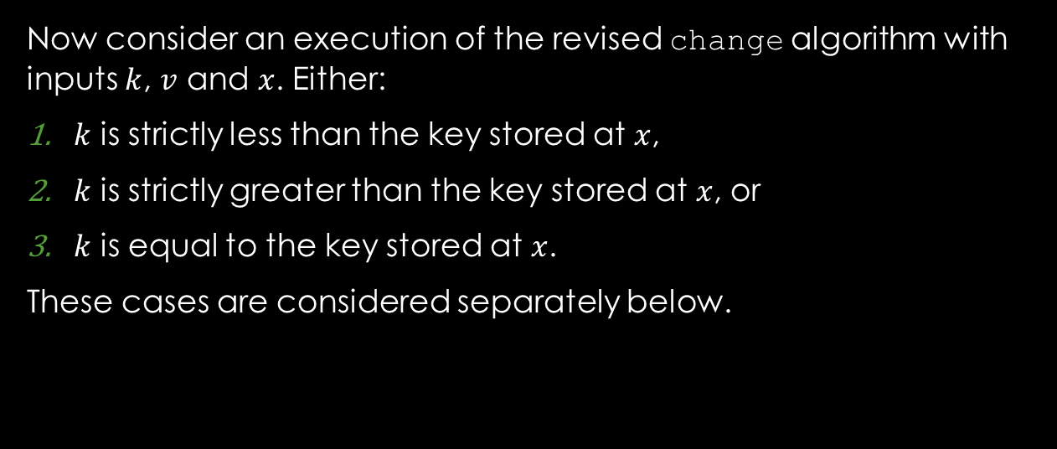
Q1: Prove the Key Property - Proof
Work Area:
Proof outline:
Now consider an execution of the revised change algorithm with inputs $k$, $v$ and $x$. Either:
$k$ is strictly less than the key stored at $x$,
$k$ is strictly greater than the key stored at $x$, or
$k$ is equal to the key stored at $x$.
These cases are considered separately below.
Basis
Inductive Step:
Inductive Hypothesis
Inductive Claim
Proof Steps
Proof Closure

Slide 9
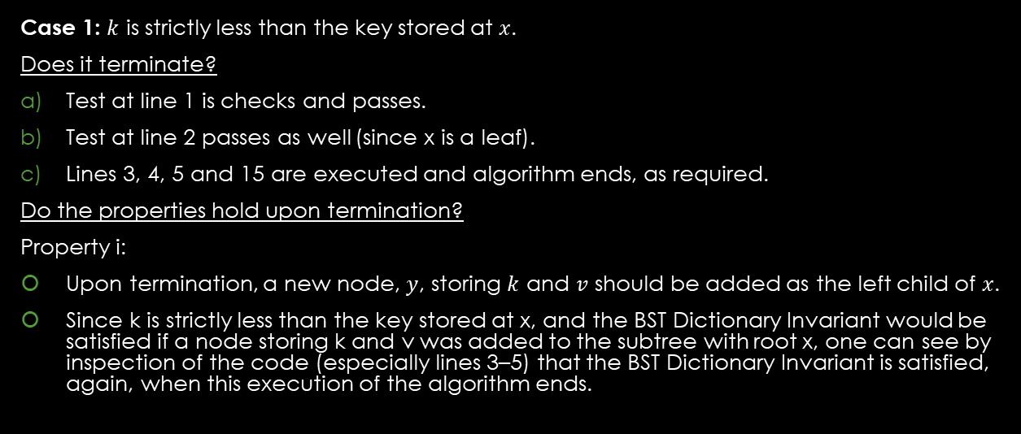
Q1: Prove the Key Property - Proof
Work Area:
Proof outline:
Case 1: $k$ is strictly less than the key stored at $x$.
Does it terminate?
Test at line 1 is checks and passes.
Test at line 2 passes as well (since x is a leaf).
Lines 3, 4, 5 and 15 are executed and algorithm ends, as required.
Do the properties hold upon termination?
Property i:
Upon termination, a new node, $y$, storing $k$ and $v$ should be added as the left child of $x$.
Since k is strictly less than the key stored at x, and the BST Dictionary Invariant would be satisfied if a node storing k and v was added to the subtree with root x, one can see by inspection of the code (especially lines 3–5) that the BST Dictionary Invariant is satisfied, again, when this execution of the algorithm ends.
Basis
Inductive Step:
Inductive Hypothesis
Inductive Claim
Proof Steps
Proof Closure

Slide 10
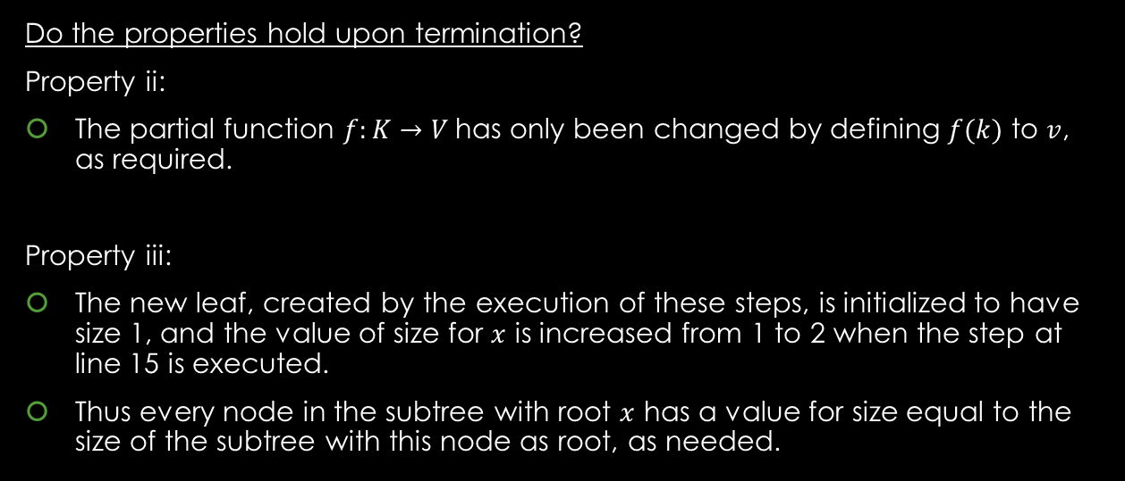
Q1: Prove the Key Property - Proof
Work Area:
Proof outline:
Do the properties hold upon termination?
Property ii:
The partial function $f:K→V$has only been changed by defining $f(k)$ to $v$, as required.
Property iii:
The new leaf, created by the execution of these steps, is initialized to have size 1, and the value of size for $x$ is increased from 1 to 2 when the step at line 15 is executed.
Thus every node in the subtree with root $x$ has a value for size equal to the size of the subtree with this node as root, as needed.
Basis
Inductive Step:
Inductive Hypothesis
Inductive Claim
Proof Steps
Proof Closure

Slide 11
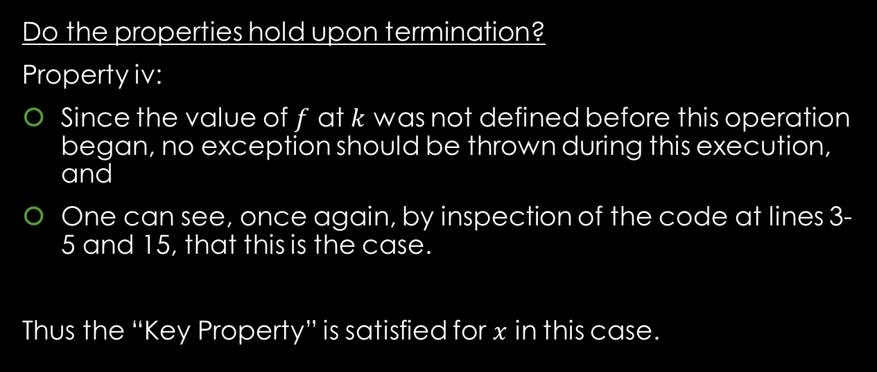
Q1: Prove the Key Property - Proof
Work Area:
Proof outline:
Do the properties hold upon termination?
Property iv:
Since the value of $f$ at $k$ was not defined before this operation began, no exception should be thrown during this execution, and
One can see, once again, by inspection of the code at lines 3-5 and 15, that this is the case.
Thus the “Key Property” is satisfied for $x$ in this case.
Basis
Inductive Step:
Inductive Hypothesis
Inductive Claim
Proof Steps
Proof Closure

Slide 12
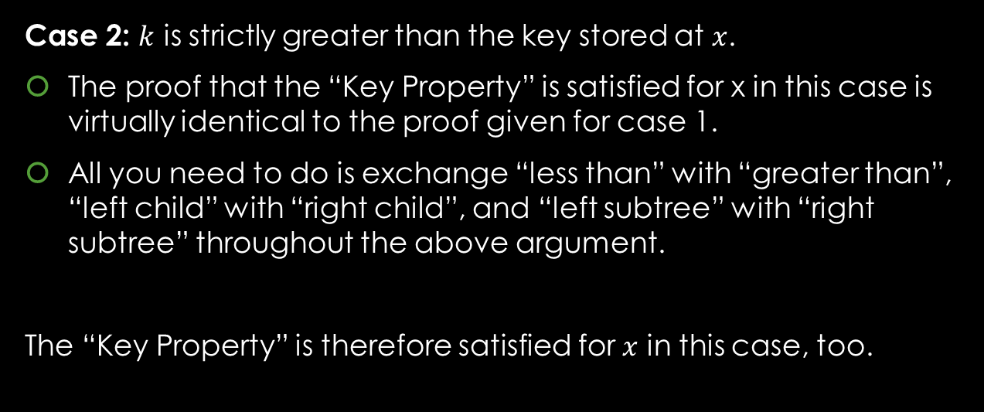
Q1: Prove the Key Property - Proof
Work Area:
Proof outline:
Case 2: $k$ is strictly greater than the key stored at $x$.
The proof that the “Key Property” is satisfied for x in this case is virtually identical to the proof given for case 1.
All you need to do is exchange “less than” with “greater than”, “left child” with “right child”, and “left subtree” with “right subtree” throughout the above argument.
The “Key Property” is therefore satisfied for $x$ in this case, too.
Basis
Inductive Step:
Inductive Hypothesis
Inductive Claim
Proof Steps
Proof Closure

Slide 13
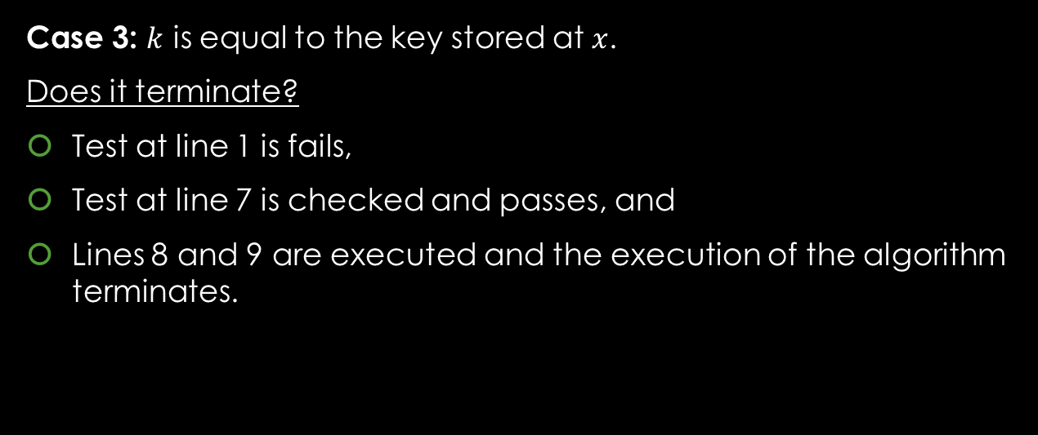
Q1: Prove the Key Property - Proof
Work Area:
Proof outline:
Case 3: $k$ is equal to the key stored at $x$.
Does it terminate?
Test at line 1 is fails,
Test at line 7 is checked and passes, and
Lines 8 and 9 are executed and the execution of the algorithm terminates.
Basis
Inductive Step:
Inductive Hypothesis
Inductive Claim
Proof Steps
Proof Closure

Slide 14
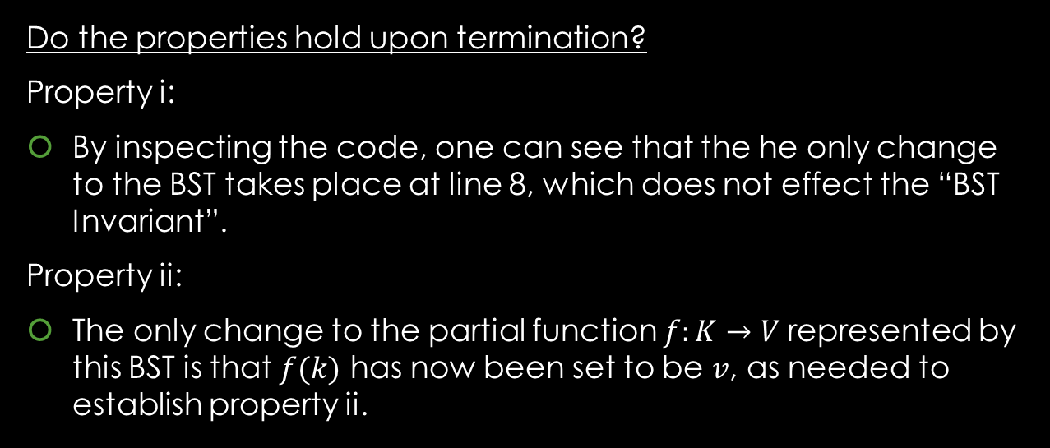
Q1: Prove the Key Property - Proof
Work Area:
Proof outline:
Do the properties hold upon termination?
Property i:
By inspecting the code, one can see that the he only change to the BST takes place at line 8, which does not effect the “BST Invariant”.
Property ii:
The only change to the partial function $f:K→V$represented by this BST is that $f(k)$ has now been set to be $v$, as needed to establish property ii.
Basis
Inductive Step:
Inductive Hypothesis
Inductive Claim
Proof Steps
Proof Closure

Slide 15
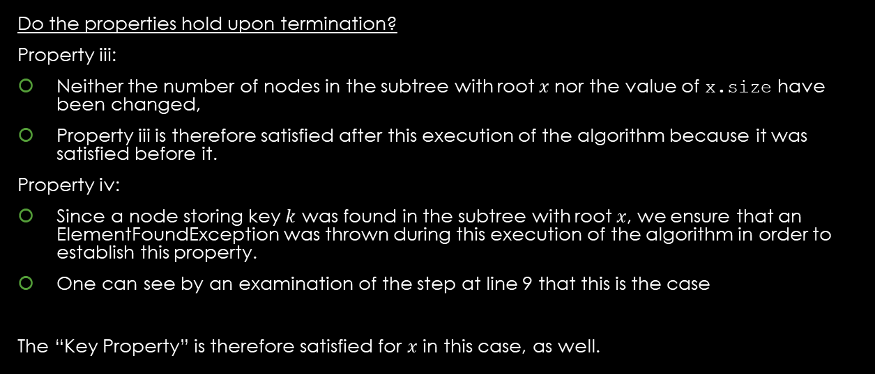
Q1: Prove the Key Property - Proof
Work Area:
Proof outline:
Do the properties hold upon termination?
Property iii:
Neither the number of nodes in the subtree with root $x$ nor the value of x.size have been changed,
Property iii is therefore satisfied after this execution of the algorithm because it was satisfied before it.
Property iv:
Since a node storing key $k$ was found in the subtree with root $x$, we ensure that an ElementFoundException was thrown during this execution of the algorithm in order to establish this property.
One can see by an examination of the step at line 9 that this is the case
The “Key Property” is therefore satisfied for $x$ in this case, as well.
Basis
Inductive Step:
Inductive Hypothesis
Inductive Claim
Proof Steps
Proof Closure

Slide 16
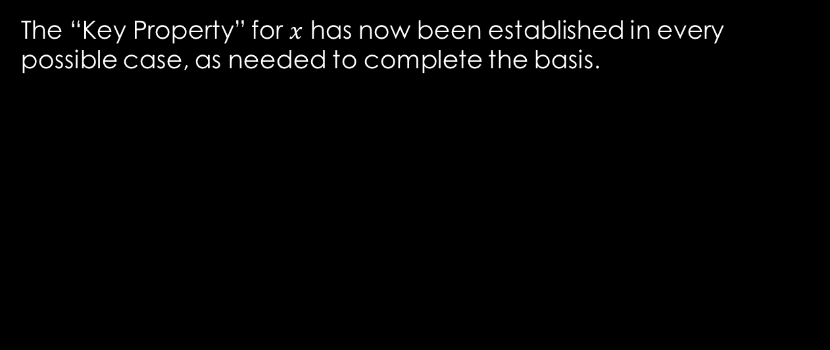
Q1: Prove the Key Property - Proof
Work Area:
Proof outline:
The “Key Property” for $x$ has now been established in every possible case, as needed to complete the basis.
Basis
Inductive Step:
Inductive Hypothesis
Inductive Claim
Proof Steps
Proof Closure

Slide 17
Q1: Prove the Key Property - Proof
Work Area:
Proof outline:
Basis
Inductive Step:
Inductive Hypothesis
Inductive Claim
Proof Steps
Proof Closure

Slide 18
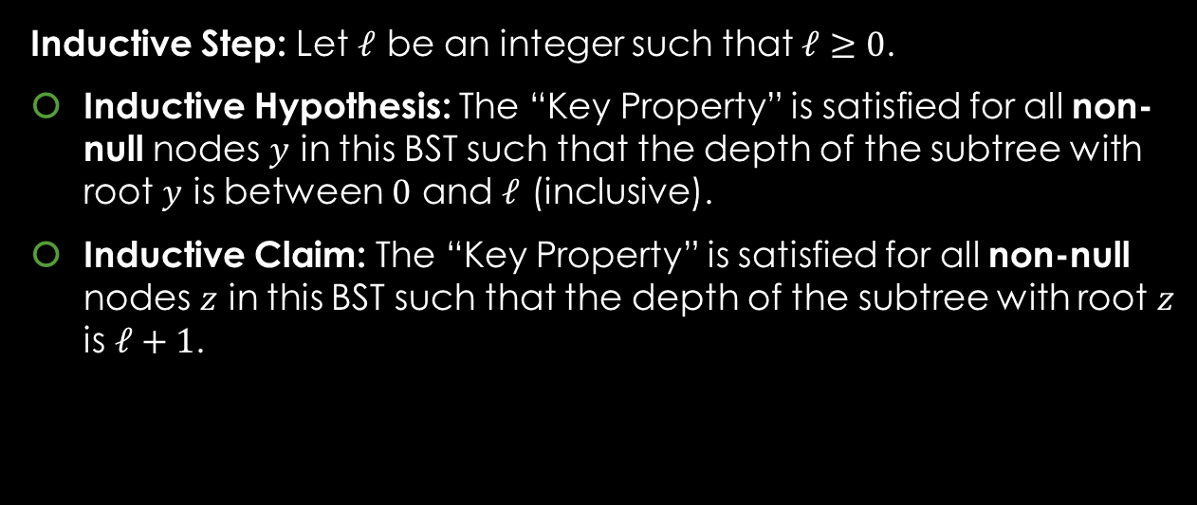
Q1: Prove the Key Property - Proof
Work Area:
Proof outline:
Inductive Step: Let $ℓ$ be an integer such that $ℓ≥0$.
Inductive Hypothesis: The “Key Property” is satisfied for all non-null nodes $y$ in this BST such that the depth of the subtree with root $y$ is between $0$ and $ℓ$ (inclusive).
Inductive Claim: The “Key Property” is satisfied for all non-null nodes $z$ in this BST such that the depth of the subtree with root $z$ is $ℓ+1$.
Basis
Inductive Step:
Inductive Hypothesis
Inductive Claim
Proof Steps
Proof Closure

Slide 19
Q1: Prove the Key Property - Proof
Work Area:
Proof outline:
Proof:
Basis
Inductive Step:
Inductive Hypothesis
Inductive Claim
Proof Steps
Proof Closure

Slide 20
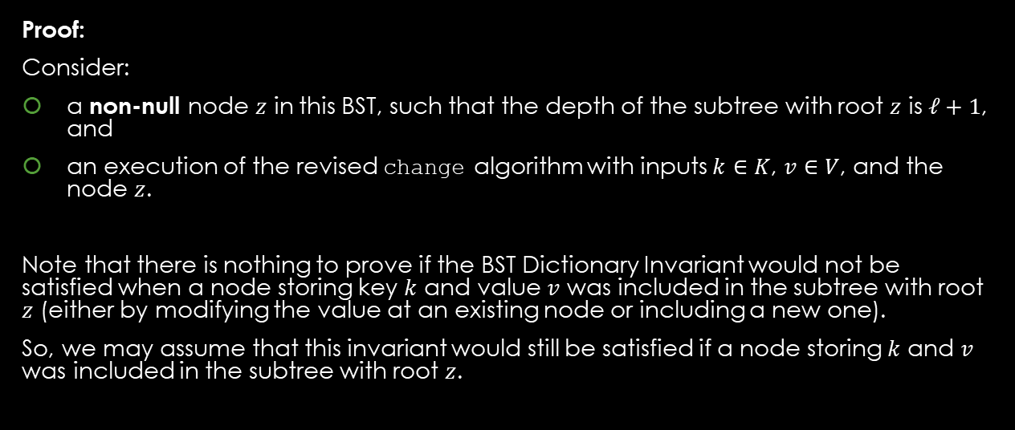
Q1: Prove the Key Property - Proof
Work Area:
Proof outline:
Proof:
Consider:
a non-null node $z$ in this BST, such that the depth of the subtree with root $z$ is $ℓ+1$, and
an execution of the revised change algorithm with inputs $k∈K$, $v∈V$, and the node $z$.
Note that there is nothing to prove if the BST Dictionary Invariant would not be satisfied when a node storing key $k$ and value $v$ was included in the subtree with root $z$ (either by modifying the value at an existing node or including a new one).
So, we may assume that this invariant would still be satisfied if a node storing $k$ and $v$ was included in the subtree with root $z$.
Basis
Inductive Step:
Inductive Hypothesis
Inductive Claim
Proof Steps
Proof Closure

Slide 21
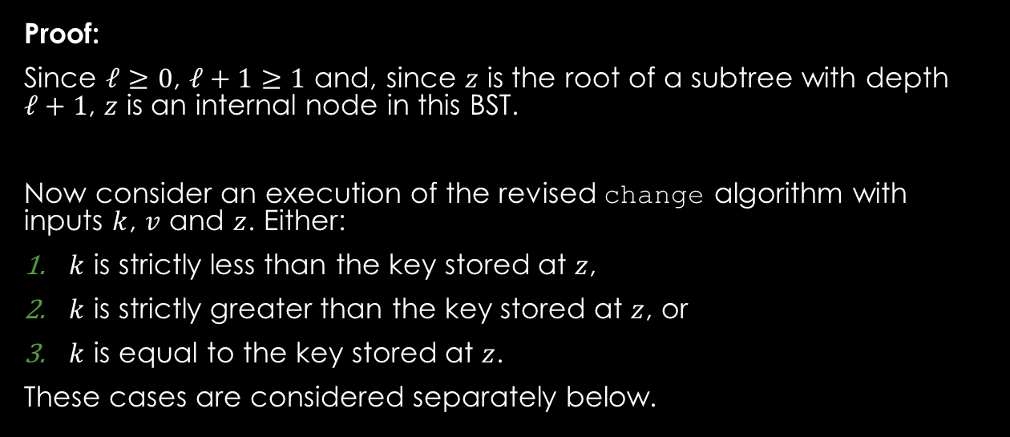
Q1: Prove the Key Property - Proof
Work Area:
Proof outline:
Proof:
Since $ℓ≥0$, $ℓ+1≥1$ and, since $z$ is the root of a subtree with depth $ℓ+1$, $z$ is an internal node in this BST.
Now consider an execution of the revised change algorithm with inputs $k$, $v$ and $z$. Either:
$k$ is strictly less than the key stored at $z$,
$k$ is strictly greater than the key stored at $z$, or
$k$ is equal to the key stored at $z$.
These cases are considered separately below.
Basis
Inductive Step:
Inductive Hypothesis
Inductive Claim
Proof Steps
Proof Closure

Slide 22
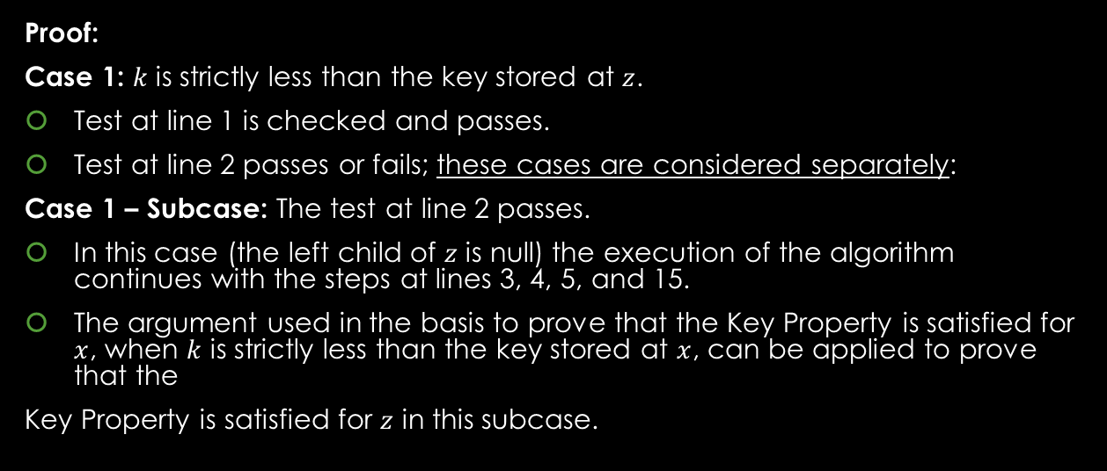
Q1: Prove the Key Property - Proof
Work Area:
Proof outline:
Proof:
Case 1: $k$ is strictly less than the key stored at $z$.
Test at line 1 is checked and passes.
Test at line 2 passes or fails; these cases are considered separately:
Case 1 – Subcase: The test at line 2 passes.
In this case (the left child of $z$ is null) the execution of the algorithm continues with the steps at lines 3, 4, 5, and 15.
The argument used in the basis to prove that the Key Property is satisfied for $x$, when $k$ is strictly less than the key stored at $x$, can be applied to prove that the
Key Property is satisfied for $z$ in this subcase.
Basis
Inductive Step:
Inductive Hypothesis
Inductive Claim
Proof Steps
Proof Closure

Slide 23
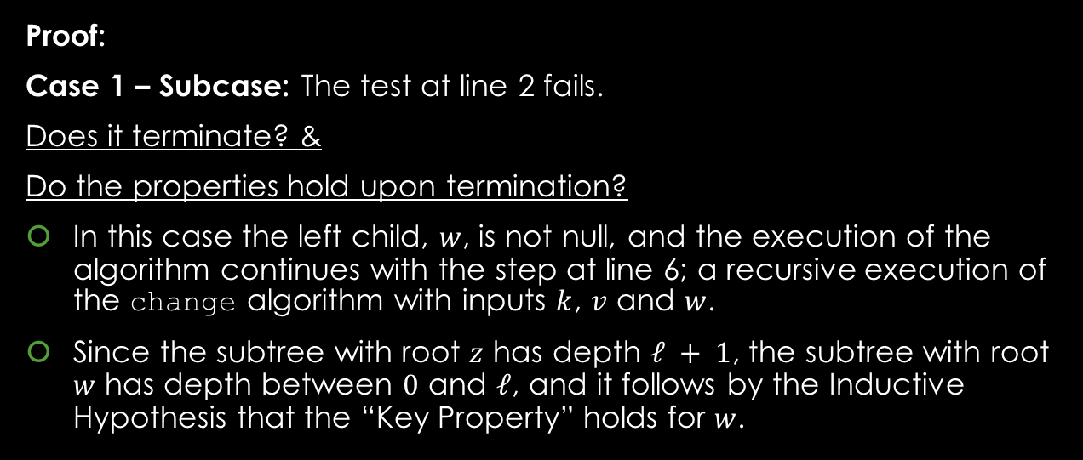
Q1: Prove the Key Property - Proof
Work Area:
Proof outline:
Proof:
Case 1 – Subcase: The test at line 2 fails.
Does it terminate? &
Do the properties hold upon termination?
In this case the left child, $w$, is not null, and the execution of the algorithm continues with the step at line 6; a recursive execution of the change algorithm with inputs $k$, $v$ and $w$.
Since the subtree with root $z$ has depth $ℓ + 1$, the subtree with root $w$ has depth between $0$ and $ℓ$, and it follows by the Inductive Hypothesis that the “Key Property” holds for $w$.
Basis
Inductive Step:
Inductive Hypothesis
Inductive Claim
Proof Steps
Proof Closure

Slide 24
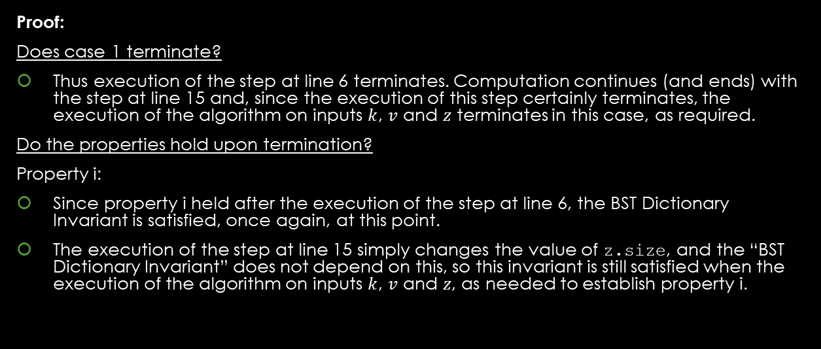
Q1: Prove the Key Property - Proof
Work Area:
Proof outline:
Proof:
Does case 1 terminate?
Thus execution of the step at line 6 terminates. Computation continues (and ends) with the step at line 15 and, since the execution of this step certainly terminates, the execution of the algorithm on inputs $k$, $v$ and $z$ terminates in this case, as required.
Do the properties hold upon termination?
Property i:
Since property i held after the execution of the step at line 6, the BST Dictionary Invariant is satisfied, once again, at this point.
The execution of the step at line 15 simply changes the value of z.size, and the “BST Dictionary Invariant” does not depend on this, so this invariant is still satisfied when the execution of the algorithm on inputs $k$, $v$ and $z$, as needed to establish property i.
Basis
Inductive Step:
Inductive Hypothesis
Inductive Claim
Proof Steps
Proof Closure

Slide 25
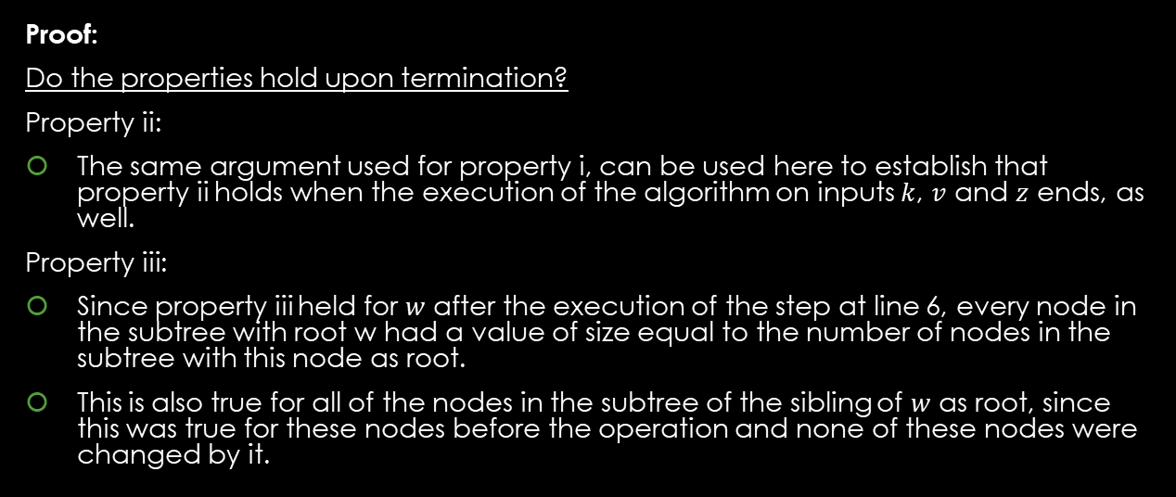
Q1: Prove the Key Property - Proof
Work Area:
Proof outline:
Proof:
Do the properties hold upon termination?
Property ii:
The same argument used for property i, can be used here to establish that property ii holds when the execution of the algorithm on inputs $k$, $v$ and $z$ ends, as well.
Property iii:
Since property iii held for $w$ after the execution of the step at line 6, every node in the subtree with root w had a value of size equal to the number of nodes in the subtree with this node as root.
This is also true for all of the nodes in the subtree of the sibling of $w$ as root, since this was true for these nodes before the operation and none of these nodes were changed by it.
Basis
Inductive Step:
Inductive Hypothesis
Inductive Claim
Proof Steps
Proof Closure

Slide 26
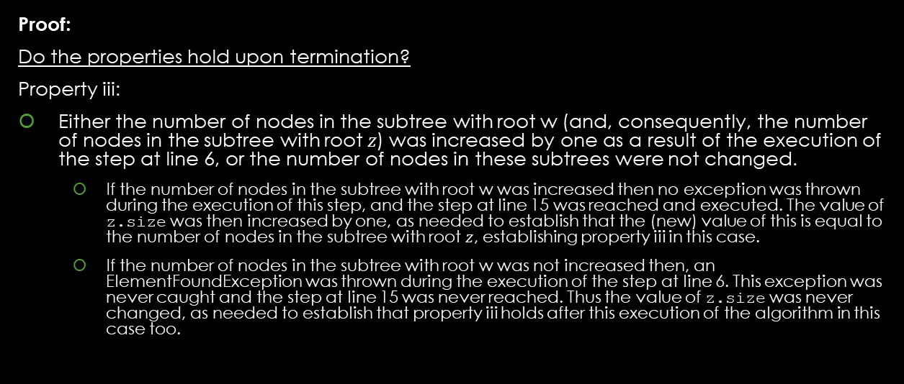
Q1: Prove the Key Property - Proof
Work Area:
Proof outline:
Proof:
Do the properties hold upon termination?
Property iii:
Either the number of nodes in the subtree with root w (and, consequently, the number of nodes in the subtree with root $z$) was increased by one as a result of the execution of the step at line 6, or the number of nodes in these subtrees were not changed.
If the number of nodes in the subtree with root w was increased then no exception was thrown during the execution of this step, and the step at line 15 was reached and executed. The value of z.size was then increased by one, as needed to establish that the (new) value of this is equal to the number of nodes in the subtree with root $z$, establishing property iii in this case.
If the number of nodes in the subtree with root w was not increased then, an ElementFoundException was thrown during the execution of the step at line 6. This exception was never caught and the step at line 15 was never reached. Thus the value of z.size was never changed, as needed to establish that property iii holds after this execution of the algorithm in this case too.
Basis
Inductive Step:
Inductive Hypothesis
Inductive Claim
Proof Steps
Proof Closure

Slide 27
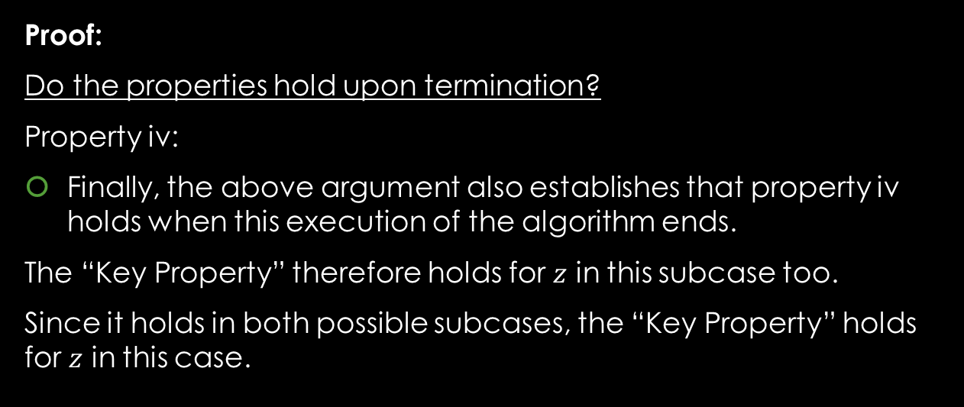
Q1: Prove the Key Property - Proof
Work Area:
Proof outline:
Proof:
Do the properties hold upon termination?
Property iv:
Finally, the above argument also establishes that property iv holds when this execution of the algorithm ends.
The “Key Property” therefore holds for $z$ in this subcase too.
Since it holds in both possible subcases, the “Key Property” holds for $z$ in this case.
Basis
Inductive Step:
Inductive Hypothesis
Inductive Claim
Proof Steps
Proof Closure

Slide 28
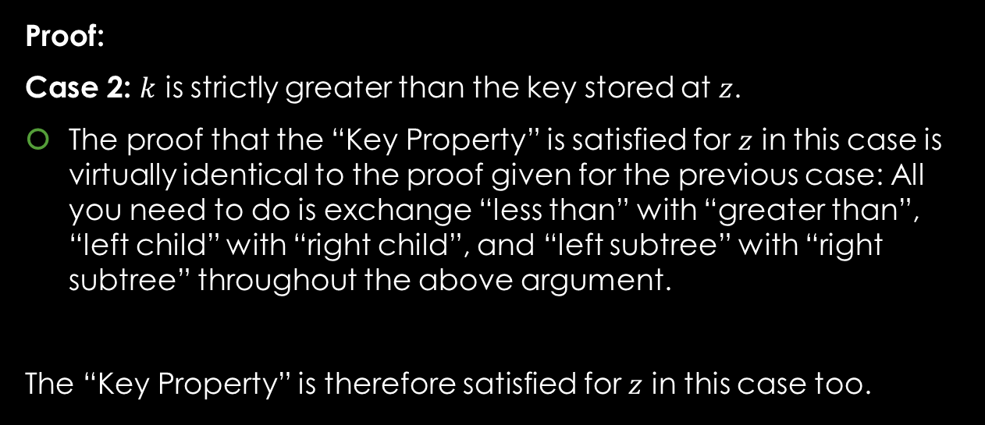
Q1: Prove the Key Property - Proof
Work Area:
Proof outline:
Proof:
Case 2: $k$ is strictly greater than the key stored at $z$.
The proof that the “Key Property” is satisfied for $z$ in this case is virtually identical to the proof given for the previous case: All you need to do is exchange “less than” with “greater than”, “left child” with “right child”, and “left subtree” with “right subtree” throughout the above argument.
The “Key Property” is therefore satisfied for $z$ in this case too.
Basis
Inductive Step:
Inductive Hypothesis
Inductive Claim
Proof Steps
Proof Closure

Slide 29
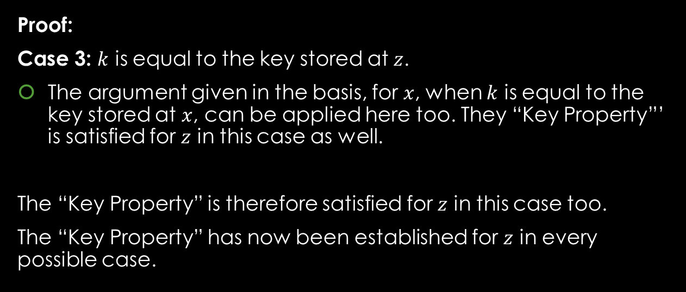
Q1: Prove the Key Property - Proof
Work Area:
Proof outline:
Proof:
Case 3: $k$ is equal to the key stored at $z$.
The argument given in the basis, for $x$, when $k$ is equal to the key stored at $x$, can be applied here too. They “Key Property”’ is satisfied for $z$ in this case as well.
The “Key Property” is therefore satisfied for $z$ in this case too.
The “Key Property” has now been established for $z$ in every possible case.
Basis
Inductive Step:
Inductive Hypothesis
Inductive Claim
Proof Steps
Proof Closure

Slide 30
Q1: Prove the Key Property - Proof
Work Area:
Proof outline:
Proof Closure:
Basis
Inductive Step:
Inductive Hypothesis
Inductive Claim
Proof Steps
Proof Closure

Slide 31
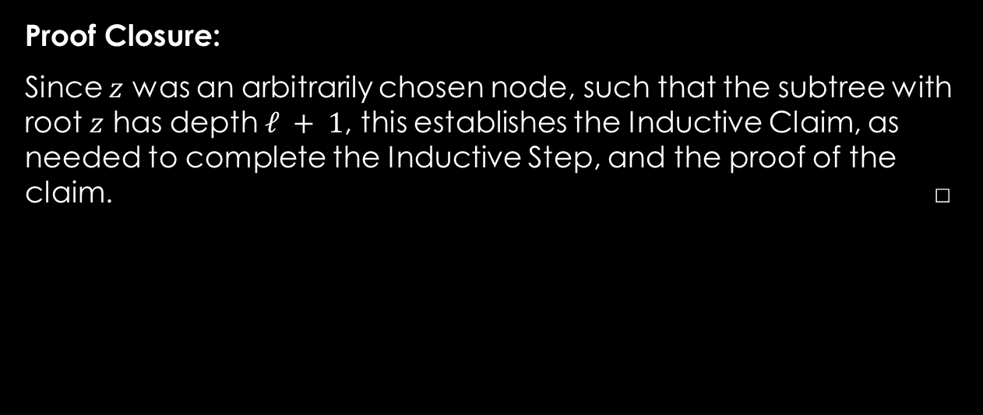
Q1: Prove the Key Property - Proof
Work Area:
Proof outline:
Proof Closure:
Since $z$ was an arbitrarily chosen node, such that the subtree with root $z$ has depth $ℓ + 1$, this establishes the Inductive Claim, as needed to complete the Inductive Step, and the proof of the claim. □
Basis
Inductive Step:
Inductive Hypothesis
Inductive Claim
Proof Steps
Proof Closure

